Slide 2
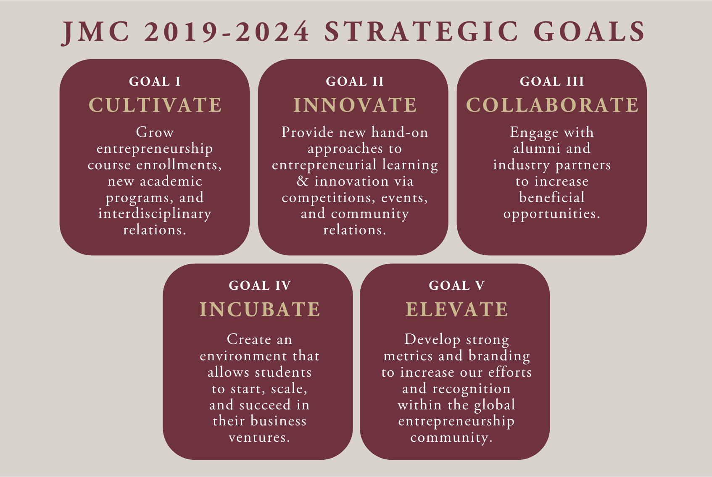
Strategic Goals & Action Plans
2019-2024

Slide 3
Strategic Goal 1: Cultivate
1.1 Grow Enrollment
1.2 Develop interdisciplinary curriculum for Entrepreneurship and Innovation (E&I) for future majors and minors across the University
1.3 Grow and develop E&I Master’s programs
1.4 Develop E&I Doctoral Programs
1.5 Create Honors courses across all programs
1.6 Preserve and showcase the Jim Moran College of Entrepreneurship (JMC) Historic Costume Collection

Slide 4
Strategic Goal 1: Cultivate Action Plans
1.1 Grow enrollment in Entrepreneurship classes; Increase enrollment in existing E&I undergraduate and graduate programs and develop new Entrepreneurship majors and minors.
1.2 Engage with EIRs and FSU colleges to continue to build interdisciplinary undergraduate and graduate majors and minors.
1.3 Grow and add Master’s programs
1.4 Add Doctoral programs
1.5 Target E&I enrollments for students in the University Honors Program
1.6 Preserve and showcase the JMC Historic Costume Collection; Digitize archives, advance recognition, and expand learning opportunities.

Slide 5
Strategic Goal 2: Innovate
2.1 Increase Entrepreneurship competitions and events
2.2 Enhance and refresh current mentor programs
2.3 Engage with local and national business community
2.4 Renovate the Merchandising space with the Innovative Retail Experience Lab
2.5 Develop Advanced Thermal Manikin Lab and add new equipment to the Textiles Testing Lab

Slide 6
Strategic Goal 2: Innovate Action Plans
2.1 Build events and increase competitions to promote E&I; Promote entrepreneurship and innovation to our students by engaging more of them in competitions and events
2.2 Increase mentor nights through our partnerships with local businesses, retailers, and Domi Station
2.3 Showcase the accomplishments of current and former members of the FSU community to inspire and encourage students to create new and innovative ventures
2.4-5 Showcase and utilize Retail Entrepreneurship labs to drive experiential learning for students.

Slide 7
Strategic Goal 3: Collaborate
3.1 Increase alumni engagement
3.2 Expand business partner participation

Slide 8
Strategic Goal 3: Collaborate Action Plans
3.1 Increase alumni engagement; JMC to have dedicated Foundation Director for fundraising and alumni engagement through targeted events, attractions, etc.. Engage faculty and staff in alumni events, mentoring, etc.
3.2 Expand business partner participation: increase student, faculty, and staff collaborations with industry partners.

Slide 9
Strategic Goal 4: Incubate
4.1 Increase and support student businesses and ventures
4.2 Develop Executive Education programs that will enhance the reputation of JMC

Slide 10
Strategic Goal 4: Incubate Action Plan
4.1 JMC will continue to support and increase participation in E&I incubators like the FSU Innovation Hub and the Domi Station. JMC will look to expand the number of venues, mentoring, funding and collaborative opportunities that our students can participate in and be exposed to for business and new venture support.
4.2 Provide a platform of experiences and tools for seasoned executives to transform their thinking and provide leadership in an entrepreneurial and dynamic manner whether in their own business or in a corporation.

Slide 11
Strategic Goal 5: Elevate
5.1 Increase ranking
5.2 Identify metrics of success
5.3 Develop JMC marketing and communications strategies, etc.

Slide 12
Strategic Goal 5: Elevate Action Plans
5.1 Improve ranking and visibility of JMC through nationally and globally recognized programs and associations.
5.2 Identify metrics of success
5.3 Develop JMC marketing and communications strategies to brank JMC through leveraging and promoting our missions, students, faculty, staff, and physical resources to both higher education and innovative partnerships.

